Slide 1
Introduction to the
Instructional Practice Guide for Mathematics
Notes:
This module was last updated on August 2018.
Facilitator Note: This module is designed to include collaborative conversations. Ensure participants are in groups and norms (see slide #4 for sample norms) are established to facilitate conversations around instruction.

Slide 2
Goals
Understand the relationship between the Instructional Shifts and the Instructional Practice Guide for Mathematics
Identify teacher and student actions that are present in college- and career-ready (CCR)-aligned lessons, as identified in the Instructional Practice Guide
Observe a lesson using the Instructional Practice Guide
Notes:
Big Idea: The Math shifts inherent in the Common Core State Standards (CCSS) require shifts in instructional practice. The Instructional Practice Guides for Mathematics are resources for ensuring alignment with College- and Career-Ready (CCR) standards.
Details:
Our goals today are first, to understand how the Instructional Practice Guides reflect the priorities of CCR standards.
And second, to practice using the IPG: Coaching Tool.
Lastly, we want to consider how these guides could be useful in your setting. How could they support teachers in ensuring students are learning in CCR-aligned environments?

Slide 3
Agenda
The Shifts We Make and the Actions We Take
Core Action 1－ Focus, Coherence, and Rigor
Core Action 2－ Instructional Practices
Core Action 3－ Student Mathematical Practices
Putting It All together
Notes:
Big Idea: This module includes the listed pieces of content.
Facilitator Note: This module is designed to be flexible. See the User’s Guide for ideas for scheduling to best meet your needs.

Slide 4
Norms
Listen with the intent to understand. Ask questions!
Focus on how this applies to your daily work. Imagine the possibilities!
Create a safe place to air confusion and raise questions. Share your ideas and encourage others to do the same.
Support ideas with evidence. Always.
Notes:
Big Idea: People can be sensitive when discussing instruction. Teachers take a risk when allowing themselves to be recorded while teaching. To honor the spirit of risk-taking and to foster a safe, collaborative environment in which student learning can be discussed, we agree to follow these working agreements.
Details:
Consider who is in the audience: Is there a range of expertise? If so, speak to how they each will engage to get the most out of the training, but also to allow others to get the most out of the training
Assume the teacher has a reason for doing what s/he is doing. Ask questions to clarify.
Keep the focus on how this may be useful to you and your colleagues – (keep us informed of innovative ways you make use of these tools.)
The tools we will use today include many places to capture and provide evidence. We’ll practice communicating using evidence in our reflections and sharing.
Facilitator Note: This slide can be replaced with established group norms or adapted as necessary.

Slide 5
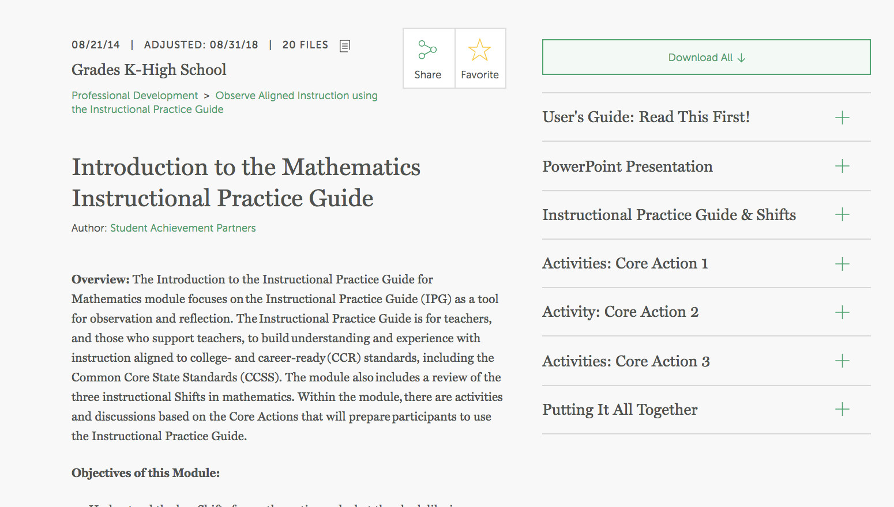
Materials for Today
Notes:
Big Idea: The materials shared today are designed to be used in a variety of settings. All materials are included in your packet today and are available at www.achievethecore.org. Please use and share them widely.
Details:
Tab your materials and make notes as you go - all these resources are available to you free on achievethecore.org https://achievethecore.org/
We cover a lot of material – each Core Action is supported at an even deeper level with tools and resources. We’ll mention those and if you find an area you would like to investigate further, or need more support with, make note of it.
Optional: Include PowerPoint with space to take notes
Optional: Provide TWO copies of the IPG, one master and one for use in Activities

Slide 6
Essential Question
What do the standards and Shifts look like in the classroom?
Notes:
Big Idea: Begin to answer the question: What do the standards and Shifts look like in the classroom?
Details:
Participants can take a few minutes to discuss with colleagues. This can serve as a good icebreaker for the room and an opportunity for the facilitator to understand more about the participants’ perspective about the standards and Shifts.
The conditions necessary for aligned classroom instruction are multiple and interconnected.
There is not just one answer to what aligned instruction looks like, nor is there one answer to what it doesn’t look like.
The best approach we can take as a learning community is to become good at naming what is and what isn’t aligned practice, by collecting and discussing enough examples and non-examples with common tools to be able to confidently identify the conditions necessary for aligned classroom instruction.
This practice will help our learning community reflect on our own systems and practice and decide which efforts are effective and where more resources are necessary to support standards-aligned instruction.

Slide 7



Key Shifts in Math
Focus strongly where the standards focus.
Coherence: Think across grades and link to major topics within grades.
Rigor: In major topics pursue conceptual understanding, procedural skill and fluency, and application with equal intensity.
Notes:
Big Idea: The most important Shifts demanded by the college- and career-ready standards for mathematics are: focus, coherence and rigor. These Shifts are supported by the college and career readiness research. Refer to the Math Shifts at a Glance handout in your packet.
Details:
Focus strongly where the Standards focus.
Coherence: think across grades, and link to major topics within grades.
Rigor: in major topics pursue:
conceptual understanding
procedural skill and fluency, and
application
with equal intensity
Depending on the group’s familiarity with the Shifts and time available, participants may be directed to read, underline and discuss the important concepts in each Shift description from the Shift at a Glance handout .
Background Knowledge: There is a 1-2 hour introductory module available at www.achievethecore.org, Professional Development: Introduction to the Math Shifts, if you would like a more detailed look at why these moves are prioritized or the research behind them.

Slide 8

What Educators Have to Say About the Shifts
https://vimeo.com/84081059
Notes:
Big Idea: In this video, we will hear from a number of teachers and educators in the field. They have internalized the Shifts in mathematics and understand the importance of implementing them in instruction.
Details:
The video can be found here: http://vimeo.com/84081059

Slide 9
Focus Strongly Where the Standards Focus
Significantly narrow the scope of content and deepen how time and energy is spent in the math classroom.
Focus deeply on what is emphasized in the Standards, so that students gain strong foundations.
Notes:
Big Idea:
The purpose of this slide is to explain focus as less topics and deeper expectations on remaining topics/major work of the grade.
Details:
What does it mean to focus? {Read slide}
So, focus in the Standards quite directly means that the scope of content is to be narrowed. This is that notion of “the power of the eraser”.
We don’t focus and do less just to do less; we focus to allow the time to go more deeply into content.
Rather than skating through a lot of topics – covering the curriculum – there are fewer topics on the list, but the expectations in those topics are much deeper. Without focus, deep understanding of core math concepts for all students cannot be realized.
A study of the Standards reveals that there are areas of emphasis already engineered into the standards at each grade level.
Background:
After a decade of NCLB, we have come to see “narrowing” as a bad word – and when it means cutting arts programs and language programs, it is. But meanwhile, math has swelled in this country. It has become a mile wide and an inch deep. The CCSSM is telling us that math actually needs to lose a few pounds.

Slide 10
Focus
Move away from "mile wide, inch deep" curricula identified in TIMSS.
Learn from international comparisons.
Teach less, learn more.
“Less topic coverage can be associated with higher scores on those topics covered because students have more time to master the content that is taught.”
– Ginsburg et al., 2005
Notes:
Big Idea:
The purpose of this slide is to cite evidence upon which the Standards were based/written, verifying that narrowing the scope of content and going deeper with the math has proven to be effective.
Details:
Many math teachers in the U.S. can relate to a “mile wide, inch deep” curriculum where instruction feels rushed. Prior to CCSSM, teachers might even realize that students don’t have a solid understanding and move on anyway, due to the pressure to cover everything.
The Trends in International Math and Science Study (TIMSS) not only ranks assessment performance of many industrialized nations, but also analyzes the education systems of those countries. It showed that curriculum in the U.S. “covers” far more topics than those countries that significantly outperform us. In fact, the TIMSS study revealed that in grade 4, high scoring Hong Kong covered only 52% of the topics assessed in TIMSS. However, the U.S., on average, covered 83%. In the U.S. we have been covering more topics with the net result of learning less about them.
Interestingly, the slogan on the Singapore Ministry of Education’s website is “Teach less, learn more.” By focusing curriculum and instruction, teachers have the opportunity to support students in the development of strong foundations that pay off as they progress through more complex math concepts.
Read quote from bottom of slide. The TIMSS study is just one example.

Slide 11
Key Areas of Focus in Mathematics
Grade | Focus Areas
K–2 | Addition and subtraction - concepts, skills, and problem solving and place value
3–5 | Multiplication and division of whole numbers and fractions – concepts, skills, and problem solving
6 | Ratios and proportional relationships; early expressions and equations
7 | Ratios and proportional relationships; arithmetic of rational numbers
8 | Linear algebra and linear functions
Notes:
Big Idea:
The purpose of this slide is to define the areas of focus/major work for K-8.
Details:
This chart shows what the major focus areas are for K-8 math. There is purpose behind the areas of focus, they are not just random.
These are the concepts which demand the most time, attention, and energy throughout the school year. It is through focus in these key areas in K-8 that students will be best be prepared for further studies of math in HS and, consequently, college and career ready.
It is important to note that these are not topics to be checked off a list during an isolated unit of instruction, but rather these priority areas will be present throughout the school year through rich instructional experiences.
Note that concepts, skills, and problem solving are focus areas in K-5, not just the skills and procedures of the operations.

Slide 12
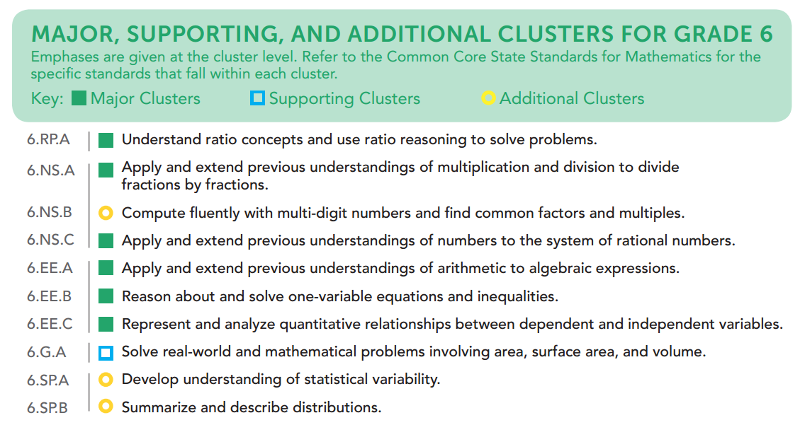
Focus by Grade Level
Achievethecore.org/focus
Notes:
Big Idea:
This slide directs participants to the “Focus by Grade Level” documents, which detail the major work of each grade K-8.
Details:
In each grade, there are explicit expectations about how to focus. The Focus by Grade Level documents make visible the intended focus and coherence of the subject matter by identifying the major work (focus) and the supporting and additional work (coherence within and across grades).
This is the focus chart for sixth grade. The green boxes represent the major work of the grade, the blue are the clusters that support the major work of the grade, and the yellow are the additional clusters. The majority of time throughout the school year should be spent on the major work in each grade.
Teachers can access these “Focus by Grade Level” documents to see the emphasis assigned to each of the content clusters of their grade level.
Note that “Supporting” and “Additional” clusters are not “Nice to Know” concepts. ALL of the standards are important, but these emphasis labels help a teacher know what is most important, which ideas support a deep conceptual understanding of the most important ideas, and which are setting the groundwork for future math concepts.
For instance, as illustrated here in 6th grade, the cluster 6.G.A is “Supporting” because it can be used to reinforce the ideas in 6.NS.A (area, surface area and volume problems involve multiplication and division, so a teacher could have students finding areas of rectangles with fractional side lengths, for instance), and 6.EE.B (students could write an equation for the area of a rectangle, where the area is known and one side length is known, and solve the equation for the other side length).
Cluster 6.SP.A, “Develop understanding of statistical variability,” which lays the groundwork for students’ study of statistics concepts in 7th and 8th grade, as well as in high school.
The shifts aren’t going to happen just because we have a great set of standards, teachers have to internalize it and use it.
For instance, the recommendation is to spend 65% to 85% of time on the major work of the grade. Teachers need to make decisions about how to spend time during the school year to achieve this.
Background Knowledge:
Participants should have easy access to this document; it should be included in handouts and can be found at www.achievethecore.org/focus. There is a A PDF file of this document for each grade, and one that includes all the K-8 Focus documents
{These designations are used by PARCC and Smarter Balanced in their test blueprints (although Smarter Balanced doesn’t distinguish between supporting and additional work).}
Note that the Model Content Frameworks (which include the high school cluster emphases) can be found here: http://www.parcconline.org/sites/parcc/files/PARCCMCFMathematicsNovember2012V3_FINAL.pdf

Slide 13
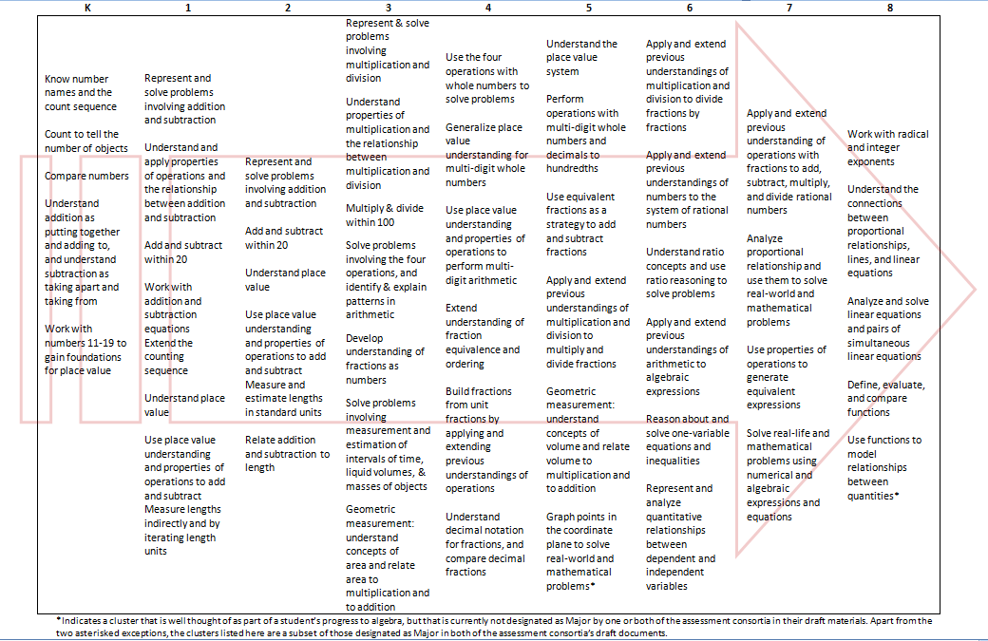
Progress to Algebra in Grades K-8
Notes:
Big Idea:
This slide shows how students progress towards algebra by focusing on the major work of each grade.
Details:
This shows the reverse side of the “Focus by Grade Level” document, with a one-page look at the major work of each grade, K-8.
This chart shows an important subset of the major work of each grade in Kindergarten – Grade 8. It is the progression that leads toward middle-school algebra. Materials should give especially careful treatment to these clusters and their interconnections.
Note that this table does not list ALL content of K-8, but just the major clusters for each grade, the focus of each grade.
If you eliminate or minimize one part of this chart there is a negative impact on students as they move forward.
This chart allows teachers to see their role in preparing students for algebra.
High school teachers will see that much of the content of previous first year courses (Algebra 1 or Math I) have shifted to grades 6, 7, and 8, preparing students for a more abstract and structural focus, rather than a procedural focus, in high school math courses.
Background Knowledge:
The K-8 progression is very well designed to create a cohesive learning experience for all students that prepares them for success in high school math courses. Each grade level holds a crucial role in the development of the requisite knowledge.

Slide 14
Focus in High School
The mile-wide inch-deep problem looks different in high school. In earlier grades its a matter of having too many topics. In high school its a matter of having too many separately memorized techniques, with no overall understanding of the structure to tie them altogether. So narrowing and deepening the curriculum is not so much a matter of eliminating topics, as seeing the structure that ties them together.
-Prof. William McCallum, 2/18/12
commoncoretools.me/2012/02/16/the-structure-is-the-standards/#comments
Notes:
Big Idea:
This slide shows how, in high school, focus is more about seeing the structure that ties different topics together.
Details:
In High School, there are not clusters designated as major work. So, focus takes on a slightly different approach.
For example, if students see that the distance formula and the trig identity sin^2(t) +cos^2(t) = 1 are both manifestations of the Pythagorean theorem, they have an understanding that helps them reconstruct these formulas rather than memorize them. The CCSS high school standards in the Algebra and Function categories are arranged under headings like “Seeing Structure in Expressions” and “Building Functions” in order to help teachers and curriculum developers see this coherence.
In high school, the shifts of focus and coherence are very closely related.

Slide 15
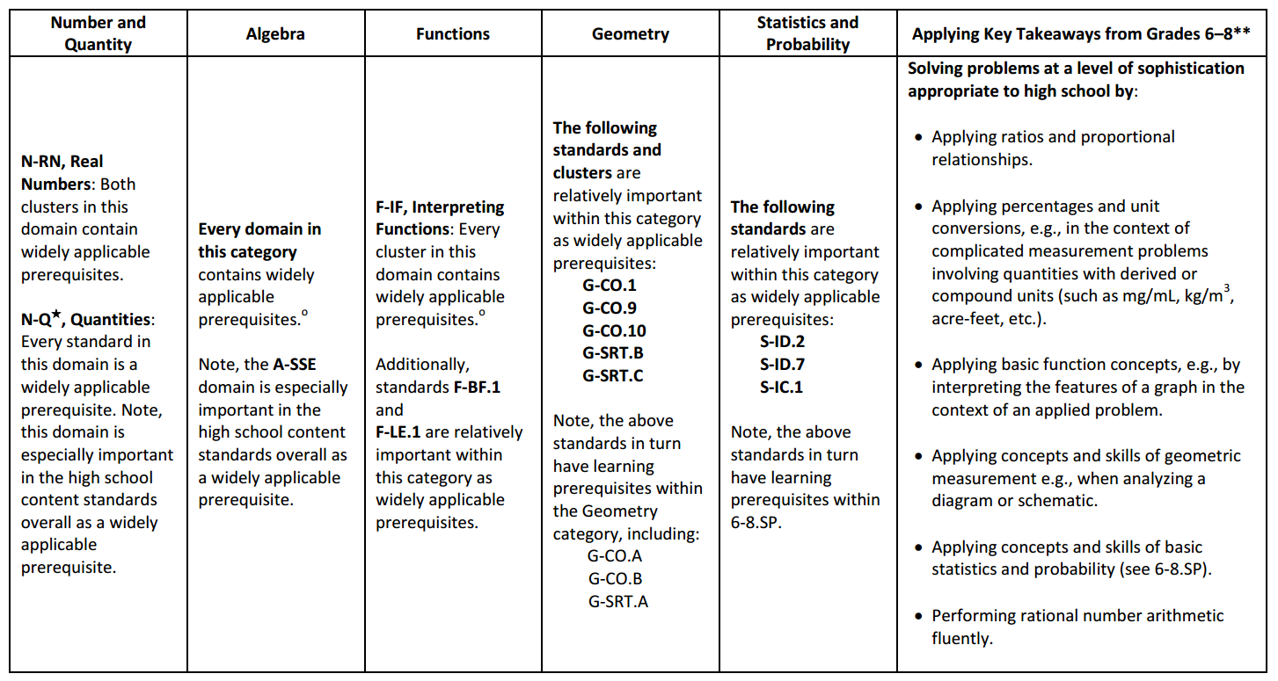
Widely Applicable Prerequisites
Achievethecore.org/prerequisites
Notes:
Big Idea:
To help understand the areas of content focus in high school, we can look at the “Widely Applicable Prerequisites” – the HS math content clusters that are applicable to the greatest number of college majors and post-high school career options. K-8 math prepares students for high school math, and high school math prepares them for college and career.
Details:
“Focus in high school is important in order to prepare students for college and careers. National surveys have repeatedly concluded that post-secondary instructors value greater mastery of a smaller set of prerequisites over shallow exposure to a wide variety of topics, so that students can build on what they know and apply what they know to solve substantial problems. A college-ready curriculum should devote the majority of students’ time to building the particular knowledge and skills that are most important as prerequisites for a wide range of college majors, post-secondary programs, and careers.” (Publishers Criteria p. 3)
This table is NOT a comprehensive list of all math content needed for students to be college-ready, but rather provides a framework for the content of focus in HS curricula.
Point out the right hand column: Much of the major work of middle school remains a focus in high school, as the concepts of proportional relationships, functions, geometric measurement, statistics and probability, and rational number arithmetic are also consider widely applicable prerequisites.
Background Knowledge:
This table is an excerpt from the publisher’s criteria for HS: http://www.corestandards.org/assets/Math_Publishers_Criteria_HS_Spring%202013_FINAL.pdf

Slide 16
Coherence: Think Across Grades, and Link to Major Topics Within Grades
Carefully connect the learning within and across grades so that students can build new understanding on foundations built in previous years.
Begin to count on conceptual understanding of core content and build on it. Each standard is not a new event, but an extension of previous learning.
Coherence in K-8 standards set students up for success in high school.
Notes:
Big Idea:
Coherence helps math make sense.
Details:
In the second Shift, coherence, we take advantage of focus to actually pay attention to sense-making in math. Just like focus, there are two elements of coherence- coherence across grades and coherence that links to major works within a grade
The standards themselves and therefore any resulting curriculum and instruction, should build on major concepts within a given school year as well as major concepts from previous years.
Coherence speaks to the idea that math does not consist of a list of isolated topics.
The Standards themselves, and therefore any resulting curriculum and instruction, should build on major concepts within a given school year as well as major concepts from previous school years.
There was a time when some math curricula spends as much as 25% of the instructional school year on reviewing and re-teaching previous grade level expectations – not as an extension – but rather as a re-teaching because many students have very little command of critical concepts.
Just as there are two ways to look at focus, there are two elements of coherence: The coherence across grades and the coherence that links topics to the major work of the grade.
HS standards have coherence in their connection to middle school standards.
If you zoom out of the high school standards and view them as a whole, you can view larger ideas providing both coherence and focus.
Background Knowledge:
The Coherence Map is a great tool to see how the standards connect across and within grades. www.achievethecore.org/coherence-map.

Slide 17
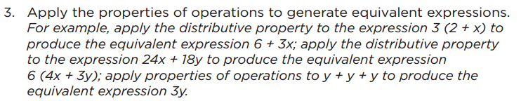
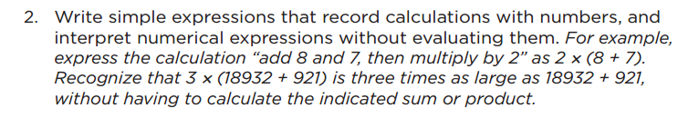
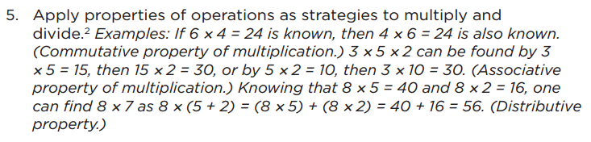

Coherence: Think across grades
One of several staircases to Algebra designed in the OA domain.
Notes:
Big Idea:
The progression of algebra is illustrated within the OA domain.
Details:
Algebra begins in 6.EE.3 in its cleanest sense. Here is a clear illustration of the design of the standards.
6.EE.3 is applying the properties of operations to algebraic expressions. As we work our way backwards we can see that students develop an understanding of each property and build upon it at the next grade level to prepare their work with algebra in the 6th grade.
Note the domains of OA and EE progresses to algebra from 1st through 6th grades, there is a coherence of properties of operations and a picture of how knowledge progresses through grades.
In grade 1, students apply properties of operations as strategies to add and subtract, including the Commutative and Associative Properties of addition.
In grade 3, students apply properties of operations as strategies to multiply and divide, including the Commutative and Associative Properties of multiplication and the Distributive Property.
In 5th grade, students are writing simple expressions that record calculations with numbers and interpret numerical expressions without solving them.
Finally, in 6th grade, students are applying the properties of operations (which they started working with in 1st grade) to generate equivalent expressions.
Consider giving participants time to discuss what they see and what this means.
Background Knowledge:
The standards were originally built as a backward staircase taking what students need to know and be able to do for college and career and scaffold back to their work in middle school and elementary.

Slide 18
Coherence: Link to Major Topics Within Grades
Example: Data Representation
1.MD.C.4 Organize, represent, and interpret data with up to three categories; ask and answer questions about the total number of data points, how many in each category, and how many more or less are in one category than in another.
Notes:
Big Idea: Supporting standards are in service of major work of the grade.
Details:
We are now going to look at coherence within grades.
Instead of bar charts being “yet another thing to cover,” detracting from focus, the standard is telling you how to “aim” bar charts back around to the major work of the grade. These connections are explicit in the standards. While in the past picture or bar graphs might have been distinct things to be assessed, now they connect to the major work of the grade.
Background Knowledge:
The standard listed above is an example of coherence within the grade level.
The MD standard listed in the slide is supporting work of the grade level which coherently connects, in the highlighted portion, the connection to the major work of third grade.

Slide 19
Coherence: Link to Major Topics Within Grades
Example: Statistics
Use the equation of a linear model to solve problems in the context of bivariate measurement data, interpreting the slope and intercept. For example, in a linear model for a biology experiment, interpret a slope of 1.5cm/hr as meaning that an additional hour of sunlight each day is associated with an additional 1.5 cm in mature plant height.
Standard
8.SP.A.3
Notes:
Big Idea
Supporting standards are in service of major work of the grade.
Details:
Instead of statistics being “yet another thing to cover,” detracting from focus, this 8th grade standard tells you how to link working with bivariate data to the major work of the grade, linear algebra and functions.
Background Knowledge:
8th grade SP is supporting work in grade 8, while linearity is major work.
This is coherence within the grade level between one domain to a specific focus cluster/topic.

Slide 20
Rigor: In Major Topics, Pursue Conceptual Understanding, Procedural Skill and Fluency, and Application with Equal Intensity
The CCSSM require a balance of:
    Conceptual understanding
    Procedural skill and fluency
    Application of skills in problem solving situations
Pursuit of all three requires equal intensity in time, activities, and resources.
Notes:
Big Idea: Make known the three aspects of rigor
Details:
What exactly does rigor mean? In the context of the Common Core State Standards other college- and career-ready standards, rigor means pursuing conceptual understanding, procedural skill and fluency, and application in the major topics.
The word rigor has been used as part of so many different agendas over time, that many people assume they know what it is and skip right past this Shift. Don’t make that mistake! Rigor, here, means something very specific. It is about the depth of what is expected in the Standards, and also about what one should expect to see happening in the classroom, in curricular materials, and so on. Rigor in the CCSS speaks to the balance of three components: conceptual understanding, procedural skill and fluency, and application.
The three components can be described as follows:
Conceptual understanding -Teachers support students’ ability to access concepts from a number of perspectives so that students are able to see math as more than a set of mnemonics or discrete procedures. Students don’t simply get to the correct answer; rather, they demonstrate deep conceptual understanding of core math concepts by applying them to new situations as well as writing and speaking about their understanding.
Procedural skill and fluency - Students are expected to have speed and accuracy with simple calculations; teachers structure class time and/or homework time for students to memorize, through repetition, core functions (e.g. multiplication tables) so they are better able to understand and manipulate more complex concepts.
Application of skills in problem solving situations - Students are expected to use math and choose the appropriate concept for application even when they are not prompted to do so. Teachers provide opportunities at all grade levels for students to apply math concepts in real world situations. Teachers in content areas outside of math, particularly science, ensure that students are using math – at all grade levels – to make meaning of and access content.
In this order for a reason – conceptual understanding develops procedural skill and fluency

Slide 21
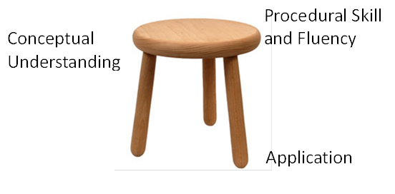
Rigor: The three-legged stool
Notes:
Big Idea: Emphasize importance of each component with the visual of the three legged stool that is representative of the balance needed for the three parts of rigor.
Details:
Imagine rigor as a three-legged stool. All three aspects of rigor (conceptual understanding, procedural skill and fluency and application) need to be addressed for students to be able to reach the depth of learning that is expected by college- and career-ready standards; each is equally critical to establishing stability.
All three aspects of rigor (conceptual understanding, procedural skill and fluency and application) need to be addressed for students to be able to reach the depth of learning that is expected by the college and career ready standards.
The three aspects of rigor are not always separate. Conceptual understanding needs to underpin fluency work; fluency can be practiced in the context of applications; and applications can build conceptual understanding.
Nor are the three aspects of rigor always together. Fluency requires dedicated practice to that end. Rich applications cannot always be shoehorned into the mathematical topic of the day. And conceptual understanding will not come along for free unless explicitly taught.
Discussion Questions:
What would happen if the application leg was really short? Procedural Skill and Fluency really long? How would this affect a child’s learning?

Slide 22
Conceptual Understanding
Teach more than “how to get the answer” and instead support students’ ability to access concepts from a number of perspectives
Students are able to see math as more than a set of mnemonics or discrete procedures
Conceptual understanding supports the other aspects of rigor (fluency and application)
Notes:
Big Idea: Explain what is meant by conceptual understanding as it relates to college and career ready standards.
Details:
One aspect of rigor is building solid conceptual understanding. Once we have a set of standards that are focused, teachers and students have the time and space to develop solid conceptual understanding.
There is no longer the pressure to quickly teach students how to superficially get to the answer, often relying on tricks or mnemonics. The standards instead require a real commitment to understanding mathematics, not just how to get the answer.
As an example, it is not sufficient to simply know the procedure for finding equivalent fractions, but students also need to know what it means for numbers to be written in equivalent forms.
Attention to conceptual understanding is one way that we can start counting on students building on prior knowledge. It is very difficult to build further math proficiency on a set of mnemonics or discrete procedures.

Slide 23
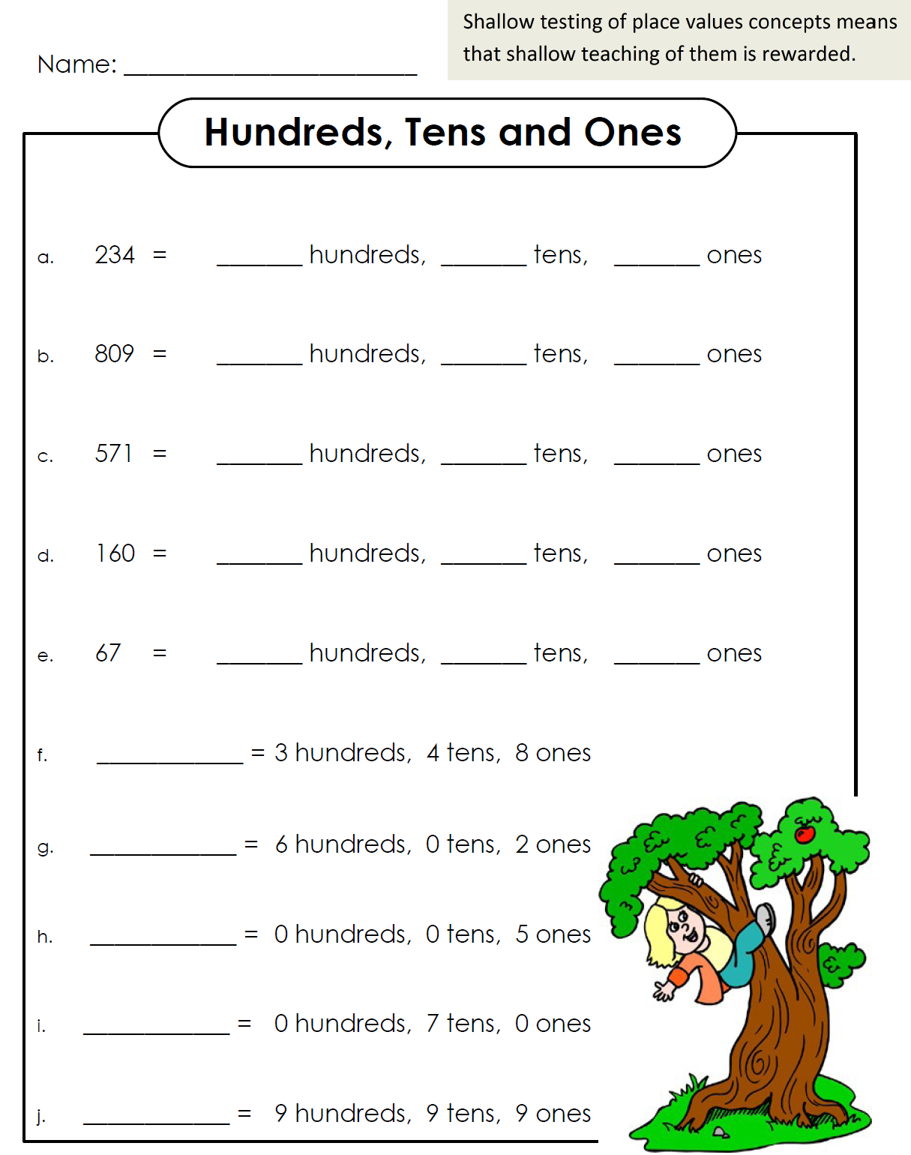
Notes:
Big Idea: Show a non-example of work that would get at conceptual understanding to contrast a strong example on the next slide
Details:
Here is an example of a place value chart that you get when you search for “place value worksheets” online. It is also a non-example of work that would elicit conceptual understanding. It would not be possible to assess whether your students had a conceptual understanding of place value by them completing this worksheet. It would be fairly obvious to a student who does not understand place value that the first number goes with hundreds, the 2nd number with tens and so on. Even on problem letters g and h, where it could have asked for deeper understanding, the worksheet places a 0 for tens to eliminate any need for thinking.

Slide 24
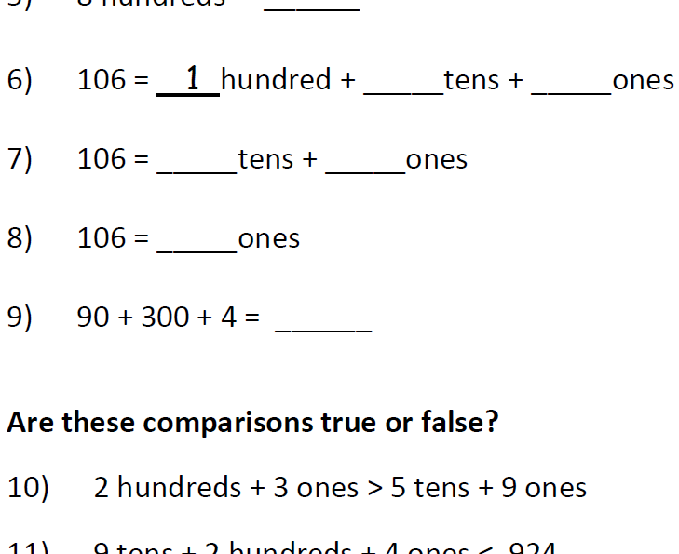
Notes:
Big Idea: Show an example of work that gets at students’ conceptual understanding
Talking Points:
In contrast, here is a snapshot of a worksheet that allows students to develop conceptual understanding about place value.
A teacher would be able to assess a student’s conceptual understanding of place value more clearly with the results of this worksheet. In problems 6-8, the base ten units in 106 are bundled in different ways. This is helpful when learning how to subtract in a problem like 106-37. In #9, we see that if the order is always given “correctly,” then all we do is teach students rote strategies without thinking about the size of the units or how to encode them in positional notation.
This worksheet also gives an example of the different ways that we can assess conceptual understanding. Oftentimes, we think that conceptual understanding is evidenced by students “explaining their thinking.” This example shows that a well-constructed fill in the blank worksheet can be a powerful tool for developing conceptual understanding.
Background Knowledge: Jason Zimba, lead author of the standards, created this document. It is an excerpt from “Thinking About Place Value in Grade 2” https://achievethecore.org/content/upload/Thinking_About_Place_Value_in_Grade_Two.pdf

Slide 25
Procedural Skill and Fluency
The standards require speed and accuracy in calculation.
Class time and/or homework time must be structured so that students can practice core functions such as single-digit multiplication
Fluency allow students to better understand and work with more complex concepts
Notes:
Big Idea: Define fluent as being fast and accurate with calculations
Details:
Another aspect of rigor is procedural skill and fluency.
Note that this is not memorization absent understanding. This is the outcome of a carefully laid out learning progression.
We can’t expect fluency to be a natural outcome without addressing it specifically in the classroom and in our materials. Some students might require more practice than others, and that should be attended to.
There is not one approach to get to speed and accuracy that will work for all students. All students, however, will need to develop a way to get there.
It is important to note here that while teachers in grades K-5 may find creative ways to use calculators in the classroom, students are not meeting the standards when they use them--not just in the area of fluency, but in all other areas of the Standards as well.
Background Knowledge: Think of fluency as compared to being fluent in a foreign language

Slide 26
Required Fluencies in K-6
Grade | Standard | Required Fluency
K | K.OA.5 | Add/subtract within 5
1 | 1.OA.6 | Add/subtract within 10
2 | 2.OA.2 2.NBT.5 | Add/subtract within 20 (know single-digit sums from memory) Add/subtract within 100
3 | 3.OA.7 3.NBT.2 | Multiply/divide within 100 (know single-digit products from memory) Add/subtract within 1000
4 | 4.NBT.4 | Add/subtract within 1,000,000
5 | 5.NBT.5 | Multi-digit multiplication
6 | 6.NS.2,3 | Multi-digit division Multi-digit decimal operations
Notes:
Big Idea: Define the required fluencies called for by the CCSSM in grades K-6
Details:
This chart shows a breakdown of the required fluencies in grades K-6.
Fluent in the particular Standards cited here means “fast and accurate.” It might also help to think of fluency in math as similar to fluency in a foreign language: when you’re fluent, you flow. Fluent isn’t halting, stumbling, or reversing oneself.
The word fluency was used judiciously in the Standards to mark the endpoints of progressions of learning that begin with solid underpinnings and then pass upward through stages of growing maturity.
Some of these fluency expectations are meant to be mental, others need pencil and paper. But for each of them, there should be no hesitation about how to proceed in getting the answer with accuracy (for example, in grade 3, the fluency expectations for adding and subtracting within 1,000 are expected to be completed with pencil and paper, when needed).

Slide 27
Application
Students can use appropriate concepts and procedures for application even when not prompted to do so.
Teachers provide opportunities at all grade levels for students to apply math concepts in “real world” situations, recognizing this means different things in K-5, 6-8, and HS.
Teachers in content areas outside of math, particularly science, ensure that students are using grade-level-appropriate math to make meaning of and access science content.
Notes:
Big Idea: Explain application as it relates to the CCSSM
Details:
Using mathematics in problem solving contexts is the third leg of the stool supporting the learning that is going on in the math classroom.
This is the “why we learn math” piece. We learn it so we can apply it in situations that require mathematical knowledge. There are requirements for application all the way throughout the grades in the CCSS.
We can’t just focus solely on application—we need also to give students opportunities to gain deep insight into the mathematical concepts they are using and also develop fluency with the procedures that will be applied in these situations. The problem-solving aspect of application is what’s at stake here—if we attempt this with a lack of conceptual knowledge and procedural fluency, the problem just becomes three times harder.
We don’t want to save all the application for the end of the learning progression. Application can be motivational and interesting, and there is a need for students at all levels to connect the mathematics they are learning to the world around them.
Background Knowledge: The problem-solving aspect of application is made possible when students have developed both conceptual knowledge and procedural fluency.

Slide 28
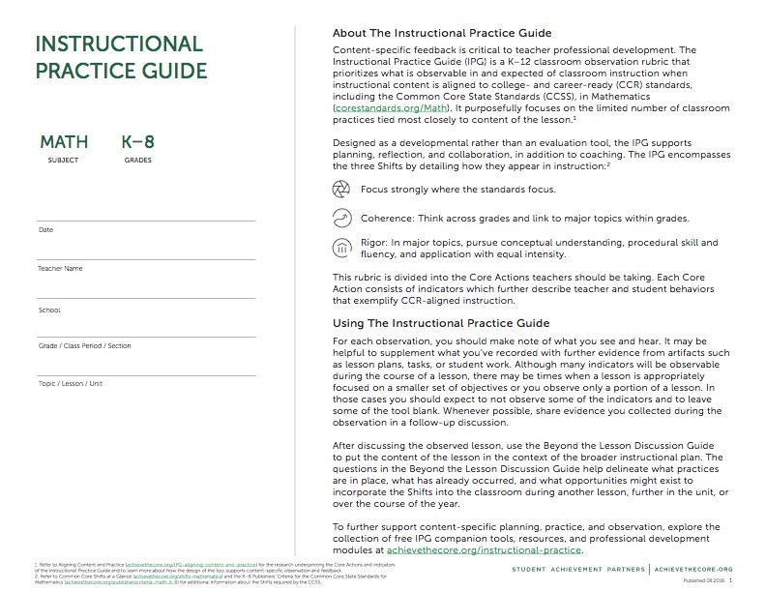
Instructional Practice Guide
Notes:
Big Idea: The Instructional Practice Guides are designed for use in coaching and collaborating around math lessons and are non-evaluative observation tools. The IPG purposefully focuses on the content of the lesson.
Details:
Instructional Practice Guides are available either digitally or in print version (https://achievethecore.org/category/1121/observe-aligned-instruction-using-the-instructional-practice-guide-coaching-tool) .
Each Instructional Practice Guide is a tool for a single lesson and is designed to capture evidence around 3 Core Actions. The Core Actions include indicators, or “look-fors”, around which evidence can be collected.
Because content expectations vary depending on grade and subject, there are different versions of the IPG. (K-8 and HS for Math and K-2 and 3-12 for ELA/Literacy.)
The first page of the print version of the Instruction Practice Guide: Coaching tool provides space for recording background information on the lesson being taught.

Slide 29
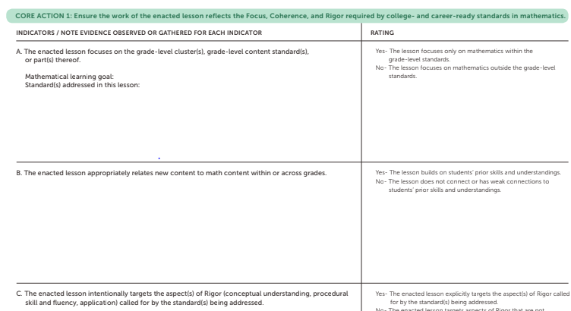
Instructional Practice Guide - Design
Core Actions
  Key Practices
  (numbered sections)
Indicators
  Observable
  (lettered details under each Core Action)
Space for evidence
Notes:
Big Idea: The IPGs (http://achievethecore.org/page/1119/coaching-tool) are available either digitally or in print version. They are designed to be used to observe a single lesson. The tools are designed for use in coaching and collaborating around mathematics lessons in most education settings and is a non-evaluative observation tool. The IPG purposefully focuses on the content of the lesson. Because content expectations vary depending on grade and subject, there are different versions of the IPG. (K-8 and HS for Math and K-2 and 3-12 for ELA/Literacy.)
Details:
There are two versions of the Math IPG: one for K-8 and one for High School. They are the same except that the K-8 version refers to “grade-level” and the HS version refers to “course-level.”
The Math IPG includes 3 Core Actions, or key practices, with the observable indicators lettered under each. There is also room for recording notes and evidence for each indicator.
The right side of the table includes a “Ratings” column. Ratings are considered optional and have been designed to offer some guiding language for discussion and calibration.
Not every indicator will be observable in every lesson.
This tool is meant as a support. This process of shifting instructional practice to meet the expectations of college- and career-readiness standards must be developmental and respectful to the hard work teachers are doing in implementing the strategies required by an emphasis on college- and career-readiness. The tool may be used for:
Coaching and feedback from instructional coaches or leaders
Teacher-to-teacher learning in PLCs, grade-level meetings or other collaborative structures
Teacher self-reflection
Lesson planning and preparation*
Background Knowledge:
*A lesson planning tool that aligns with the IPG is available at www.achievethecore.org/lesson-planning-tool

Slide 30
Summary of
Core Actions
Notes:
Big Idea: The second page lists each Core Action and the Indicators for each.
Details:
Reading over this page will give you an idea of all of the Core Actions and Indicators before taking a closer look at each one in the pages that follow.
This is also useful for a quick reference to the Core Actions and Indicators without the rating language.

Slide 31
Core Actions for Mathematics in the IPG
Ensure the work of the enacted lesson reflects the Focus, Coherence, and Rigor required by college- and career-ready standards in mathematics.
Employ instructional practices that allow all students to learn the content of the lesson.
Provide all students with opportunities to exhibit mathematical practices while engaging with the content of the lesson.
Notes:
Big Idea: Share the Core Actions that the IPG names for observing CCR-aligned instructional practice
Details:
We will be taking a look at a specific tool for observing CCR-aligned instructional practice. This tool names three overarching Core Actions that indicate alignment.
Each of these Core Actions has more detailed descriptions of what to look for, but they will serve as a frame for us throughout our work today or analyzing a lesson observation, lesson plan, and student work.
You will notice that both Core Actions 2 and 3 reference “content.” It is important to remember that, as we look at teacher actions and how the practices play out in the classroom, they are all in service of students learning the specific mathematical content of the grade.

Slide 32
Beyond the Lesson
The Beyond the Lesson Discussion Guide can help you continue the post-observation conversation.
Notes:
Big Idea: The Beyond the Lesson Discussion Guide provides more opportunity to consider the evidence of the Shifts beyond the scope of a single lesson.
Details:
Have participants get out their copies of the IPG so they can see the Beyond the Lesson Guide and how integral it is to the IPG. It is always the final page of all of the IPGs.
The Beyond the Lesson Discussion Guide is designed for the post-observation conversation using the Instructional Practice Guide Coaching Tool (achievethecore.org/coaching-tool) or any other observation rubric.
The questions put the content of the lesson in the context of the broader instructional plan for the unit or year.
After discussing the observed lesson, select several appropriate “Beyond the Lesson” (BTL) questions to help clearly delineate what practices are in place, what has already occurred, and what opportunities might exist in another lesson, further in the unit, or over the course of the year to incorporate the Shifts into the classroom.
The IPG Coaching Tool only captures one lesson or one day's work but, without addressing what is done before and after and how this lesson fits into the work of a unit or larger time frame, it is impossible to gain a valid sense of how instruction is or is not preparing students for college and career over time. The BTL discussion guide questions are designed to address the broader instructional context.
Not all questions need to be raised at once, but all of the questions are of equal importance.
Point out the fact that some of the most crucial CCR standards cannot really be seen in a given lesson. Time spent on major work, for example, can only be understood over the course of the year.
The balance of the aspects of Rigor is also something that should be discussed in the context of a unit or the year. Many lessons may only target one aspect of Rigor, depending on the standards they are targeting.

Slide 33
The Shifts, Core Actions, and Beyond the Lesson
Read/scan the IPG and Beyond the Lesson Discussion Guide. Jot down any questions that come up.
What is the purpose of the Instructional Practice Guide and Beyond the Lesson Discussion Guide?
Consider the Shifts throughout both documents. Highlight or underline where you see evidence of the Shifts throughout the tools.
Notes:
Big Idea: Connect the ideas behind the Shifts with the IPG and BTL Discussion Guide. Give participants an opportunity to scan the templates for the arc of the work in the IPT.
Details:
Provide participants with copies of the IPG & BTL Discussion Guide (last page of the IPG).
Allow time for participants to complete the suggested activities on the slide at their tables. They should be able to identify all three Shifts within the IPG and the Beyond the Lesson Discussion Guide. If you have ample time, provide three different-colored highlighters to the participants so they can color code the document by Shifts.

Slide 34
Core Action 1
Ensure the work of the enacted lesson reflects the Focus, Coherence, and Rigor required by college- and career-ready standards in mathematics.
The enacted lesson focuses on the course-level cluster(s), course-level content standard(s), or part(s) thereof.
The enacted lesson appropriately relates new content to math content within or across grades.
The enacted lesson intentionally targets the aspect(s) of Rigor (conceptual understanding, procedural skill and fluency, application) called for by the standard(s) being addressed.
Highlight 4-7 key words in each indicator including the rating language.
Notes:
Big Idea: The first Core Action is directly related to the Shifts: Focus, Coherence, and Rigor. The indicators included in Core Action 1 describe how the lesson should be structured in order to ensure that instruction reflects the Shifts.
Details:
Read each indicator. Ask participants to highlight 4–7 key words from each indicator. Have participants share the words they chose.
Suggested answers for both indicators and ratings are bolded:
1A. The enacted lesson focuses on the grade/course-level cluster(s), grade/course-level content standard(s), or part(s) thereof.
Yes- The lesson focuses only on mathematics within the grade/course-level standards.
1B. The enacted lesson appropriately relates new content to math content within or across grades.
Yes- The lesson builds on students’ prior skills and understandings.
1C. The enacted lesson intentionally targets the aspect(s) of Rigor (conceptual understanding, procedural skill and fluency, application) called for by the standard(s) being addressed.
Yes- The enacted lesson explicitly targets the aspect(s) of Rigor called for by the standard(s) being addressed.
Background Knowledge:
While some indicators from Core Actions 2 and 3 may not be observed in every lesson, or may not be the focus of every observation, all lessons should observe for the focus, coherence, and rigor that are make up Core Action 1.

Slide 35
Core Action 1: Finding Evidence
Indicator | What shift is this related to? | What information might be helpful to rate this indicator? | What are some artifacts that would provide evidence of this indicator? | What are examples of this indicator being met and not being met?
A) The enacted lesson focuses on the course-level cluster(s), course-level content standard(s), or part(s) thereof.
Notes:
Big Idea: Practice determining what the indicators in Core Action 1 could look like in practice.
Details:
Facilitators should choose whether to complete Indicator A (1A) as a group before giving time for participants to complete the rest of the table.
The most important part of using the coaching tool is to find evidence that supports the presence (or absence) of each indicator. We will start by thinking through each indicator and identifying the Instructional Shift it is related to, as well as how we would go about finding evidence.
Debrief the activity by having participants share evidence that they’ve found. [Refer to the ANSWER KEY for suggested responses]

Slide 36
Core Action 1: Lesson Plan Review
Carefully read the lesson plan.
Note evidence that shows the lesson meeting or not meeting each indicator for Core Action 1. (Do not rate the indicators.)
Be ready to share the evidence you found.
Notes:
This activity is optional.
Big Idea: Analyze a lesson plan to look for evidence for the planning for Core Action 1.
Details:
We are now going to do an activity designed to let you practice finding evidence of planning for Core Action 1. Note – Core Action 1 is about the enacted lesson – not the plan itself. You will review a lesson plan and take notes on the indicators for Core Action 1. You are NOT rating the indicators, but instead just look for evidence and note it on the Instructional Practice Guide. This is just an exercise to get your feet wet. As an observer, you might review a lesson plan prior to an observation but the lesson must be observed before indicators can be rated.
Directions for activity:
Distribute a lesson plan to teachers that is within the appropriate grade-band for the group (Handout #2-5, or use a lesson plan of your choosing).
Remind participants that they are not rating the indicators.
Give participants time to read the lesson plan and write evidence for each indicator in Core Action 1.
Debrief the activity by having participants share evidence that they’ve found for each indicator.

Slide 37
How do I know if the lesson reflects the Shifts?
Is the lesson addressing on grade-level content?
What is the intent of the standard(s) being addressed?
Is the aspect of rigor required by the standard(s) the same as the aspect(s) being addressed in the lesson?
How does the lesson connect to and build on students’ prior skills and knowledge?
Digital Planning Tool available at achievethecore.org/lesson-planning-tool
Notes:
Big Idea: When considering evidence for Core Action 1, these questions are helpful to consider, either in advance of a lesson in planning or after a lesson as a reflection activity
Details:
There are times when teachers or those who support teachers might wonder how they will know if a lesson does indeed, reflect the Shifts. These questions were created from the indicators for Core Action 1. Reflecting on these questions can assist in determining whether or not a lesson accurately reflects the Shifts. These questions can be used before a lesson is taught as a way to help in the planning process or they can be used after a lesson has been taught as a way to reflect on the lesson and self-assess the alignment of the lesson to the instructional shifts required. The Digital Planning Tool, which we will learn about later in the presentation, is a web-based tool that helps teachers think through these “How Will I Know” questions as they are planning their lesson.

Slide 38
Core Action 2
Employ instructional practices that allow all students to learn the content of the lesson.
Indicators
The teacher makes the mathematics of the lesson explicit through the use of explanations, representations, tasks, and/or examples.
The teacher strengthens all students’ understanding of the content by strategically sharing students’ representations and/or solution methods.
The teacher deliberately checks for understanding throughout the lesson to surface misconceptions and opportunities for growth, and adapts the lesson according to student understanding.
The teacher facilitates the summary of the mathematics with references to student work and discussion in order to reinforce the purpose of the lesson.
Notes:
Big Idea: The purpose of the slide is to share the indicators for Core Action 2
Details:
Core Action 2 is about students learning the content of the lesson through rich instructional experiences provided by the teacher. Notice how each indicator begins with the words, “The teacher…” This is to say that the instructional practices a teacher implements are important in getting all students to learn the content of a particular lesson and should be planned and executed purposefully.

Slide 39

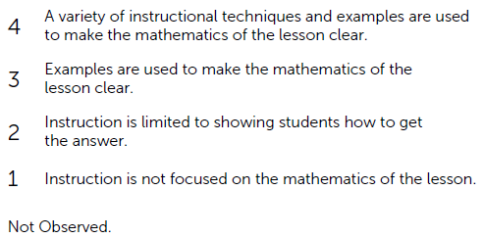
Core Action 2: A Closer Look
A. The teacher makes the mathematics of the lesson explicit through the use of explanations, representations, tasks, and/or examples.
Notes:
Big Idea: Noting the rating language in Core Action 2.
Details:
Let’s take a closer look at Core Action 2. First, it’s important to notice the difference in the way Core Action 2 is rated versus Core Action 1. In Core Action 1, the indicators were rated using YES and NO. Either the lesson does or does not reflect the focus, coherence, and rigor called for by the Standards.
In Core Action 2, the indicators are more nuanced, so they are rated on a scale from 1–4, with 4 describing what the indicator looks like in an ideal classroom. The way each numerical rating is described is meant to help the observer and the teacher know how the lesson can be strengthened to better meet the indicators highest rating. It also shows that a teacher can be taking steps in the right direction to ensure his/her instructional practices are allowing all students to learn the content of the lesson.
Background Knowledge: Indicator 2A is about making the mathematics of the lesson explicit through the use of explanations, representations, and/or examples. This does not mean showing students how to get the answer. Rather, this means that the teacher is making the mathematics clear through the use of a variety of instructional techniques, enabling all students to see various ways of solving a problem. This indicator can be met by teachers using a variety of instructional approaches – some lessons may call for direct instruction and sometimes a clear explanation from a teacher in the midst of a discovery lesson is the heart of the lesson. Regardless of the approach, it is important that the teacher does not use mnemonics or tricks as a way to explain the mathematics.

Slide 40
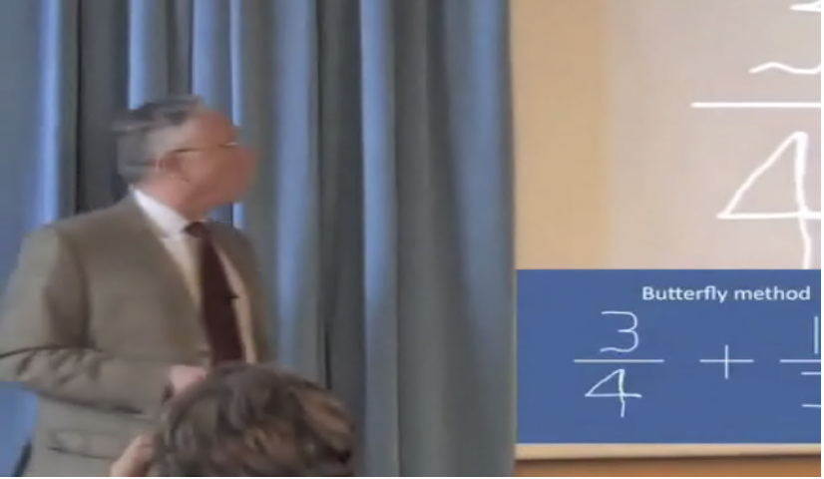
Don’t Leave Out the Math:
Phil Daro on Teaching
Notes:
Big Idea: Video to highlight the importance of making the mathematics of the lesson clear – compare to answer-getting.
Details:
We are going to watch a short video from Phil Daro, one of the lead authors of the Common Core Math Standards, talking about the value of teaching mathematics in greater depth. As you’re watching, think about how his points relate to Indicator 2A.
Video can be found at http://vimeo.com/81633860

Slide 41
Core Action 2: Finding Evidence
Each small group will be assigned one indicator from Core Action 2
Highlight 4 – 7 key words in the indicator, including words from the scale
Describe 2 or 3 examples that would show this indicator being met
Describe 1 or 2 examples that would show this indicator not being met
Notes:
Big Idea: Dive a little deeper into each indicator in Core Action 2.
Details:
We are now going to do an activity to get you thinking about finding evidence again, this time for Core Action 2.
Directions for activity:
Distribute Handout #6 to each participant.
Give the small groups time to read through the indicator and highlight key words.
Give groups time to identify examples that show the indicator being met and not being met. (Refer to the ANSWER KEY for key words and suggestions for answers to the questions.)
Debrief the activity by having participants share what they came up with. All participants should highlight the key words for each indicator, including those that were not assigned to them. Encourage a whole group discussion where participants add to and ask questions of the ideas of others.

Slide 42
How do I know if the instructional practices allow all students to learn the content of the lesson?
How is the mathematics of the lesson made explicit? How does the instruction go beyond just getting the answer?
How does the teacher check for understanding? How does the lesson change based on those checks?
What student solution methods are shared to support understanding?
How is the mathematics of the lesson summarized?
Digital Planning Tool available at achievethecore.org/lesson-planning-tool
Notes:
Big Idea: When considering evidence for Core Action 2, these questions are helpful to consider, either in advance of a lesson in planning or after a lesson as a reflection activity
Details:
There are times when teachers or those who support teachers might wonder how they will know if instructional practices allow all students to learn the content of the lesson. These questions were created from the indicators for Core Action 2. Reflecting on these questions can assist in determining whether or not a lesson is designed with all students’ learning in mind. These questions can be used before a lesson is taught as a way to help in the planning process or they can be used after a lesson has been taught as a way to reflect on the lesson and self-assess the alignment of the lesson to the instructional practices that are necessary in lessons aligned to the Common Core and other college- and career-ready standards. The Digital Planning Tool, which we will learn about later in the presentation, is a web-based tool that helps teachers think through these “How Will I Know” questions as they are planning their lesson.

Slide 43
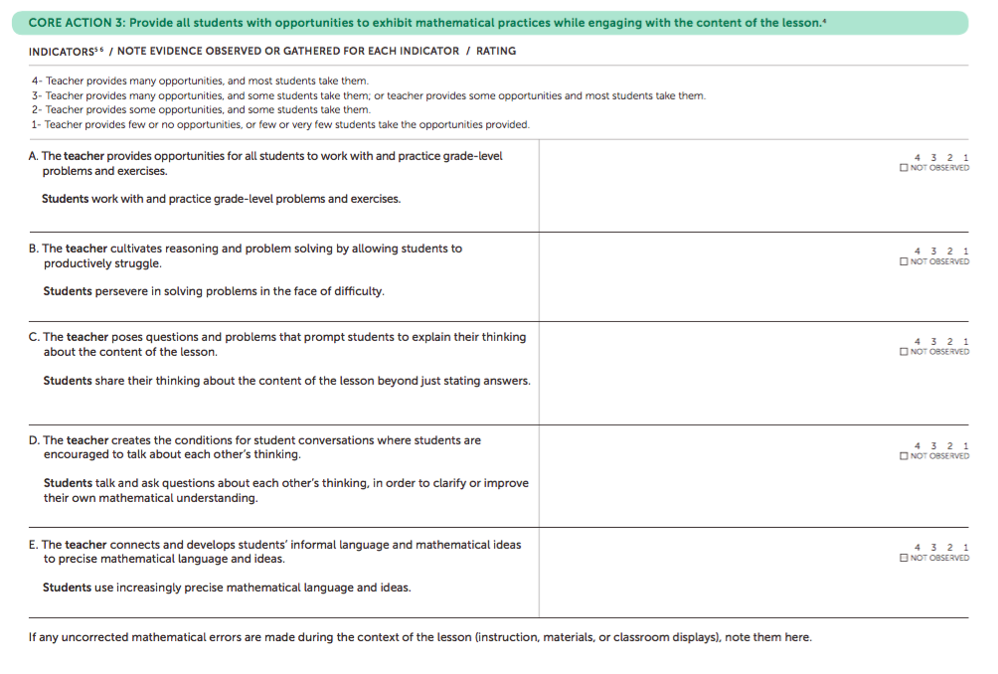
Core Action 3
Notes:
Big Idea: The purpose of the slide is to share the indicators for Core Action 3
Details:
Now let’s look move to Core Action 3. Take a few minutes to read through the five indicators for Core Action 3.
Core Action 3 is about students demonstrating the mathematical practices called for in the Common Core and other college- and career-ready standards, in relation to the content of the lesson. There are five indicators for Core Action 3.

Slide 44
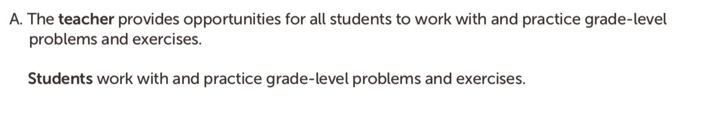
Core Action 3
⁵ Some or most of the indicators should be observable in every lesson, though not all will be evident in all lessons.
Notes:
Big Idea: Noting the rating language in Core Action 3.
Details:
Let’s take a closer look at the Core Action 3. You’ll notice that each of the indicators has two parts – one that describes the teacher action and one that describes the student action. Because this Core Action is about the Practices, we have to look at student actions to see if the indicators are being met.
The scale is also different from the ones in Core Actions 1 and 2. The language for the 1-4 ratings are the same for every indicator in Core Action 3. At the top end of the scale, the teacher is providing opportunity consistently and most students are demonstrating the behavior associated with the indicator. On the opposite end of the scale, the teacher fails to provide opportunity and very few students demonstrate the given behavior. In preparing to rate the indicators for Core Action 3, evidence should be gathered that illustrates both the teacher actions and student behaviors, which will lead to a more accurate rating for each.
As is noted in the footnote, while not every indicator will be evident in all lessons that are taught and observed, some or most of the indicators should be observable. Students should be presented with opportunities to exhibit the mathematical practices in relation to the content of the lesson on a daily basis. In the case where an indicator is not observed in a lesson, it should be left blank.

Slide 45
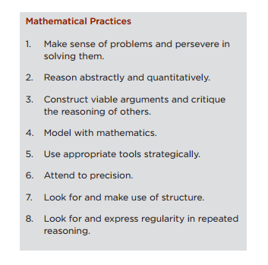
Standards for Mathematical Practice
There is not a one-to-one correspondence between the indicators for Core Action 3 and the Standards for Mathematical Practice. These indicators and the associated illustrative student behavior collectively represent the Standards for Mathematical Practice that are most easily observable during instruction.
Notes:
Big Idea: Explain the relationship between the Math Practices and the indicators of Core Action 3.
Details:
There are eight standards for mathematical practice and only five indicators in Core Action 3, which means there is not a one-to-one correspondence in indicators in Core Action 3.
The intent of the Core Action 3 indicators is to focus on the math practices that are most easily observable during instruction.
The lack of one-to-one correspondence is not intended to imply that some math practices are more important than others, or than some can be disregarded by teachers.
Students should be presented with opportunities to exhibit the mathematical practices in relation to the content of the lesson on a daily basis.

Slide 46
Core Action 3: Finding Evidence
Provide all students with opportunities to exhibit mathematical practices while engaging with the content of the lesson.
The teacher provides opportunities for all students to work with and practice course-level problems and exercises. Students work with and practice course-level problems and exercises.
The teacher cultivates reasoning and problem solving by allowing students to productively struggle. Students persevere in solving problems in the face of difficulty.
The teacher poses questions and problems that prompt students to explain their thinking about the content of the lesson. Students share their thinking about the content of the lesson beyond just stating answers.
The teacher creates the conditions for student conversations where students are encouraged to talk about each other’s thinking. Students talk and ask questions about each other’s thinking, in order to clarify or improve their own mathematical understanding.
The teacher connects and develops students’ informal language and mathematical ideas to precise mathematical language and ideas. Students use increasingly precise mathematical language and ideas.
Highlight 4–7 key words in each indicator for Core Action 3.
Notes:
Big Idea: Dive a little deeper into each indicator in Core Action 3.
Details:
Take a few minutes now, either working independently or with someone near you, to read and highlight 4–7 key words in each indicator for Core Action 3. Remember to include important language from both parts of the indicator: teacher actions and student behaviors. We’ve already discussed the scale and since it remains the same throughout the entire Core Action, we won’t include it in our 4–7 key words.
{Have participants share the key words they chose.}
Suggested answers are bolded:
The teacher provides opportunities for all students to work with and practice grade/course-level problems and exercises. Students work with and practice course-level problems and exercises.
The teacher cultivates reasoning and problem solving by allowing students to productively struggle. Students persevere in solving problems in the face of difficulty.
The teacher poses questions and problems that prompt students to explain their thinking about the content of the lesson. Students share their thinking about the content of the lesson beyond just stating answers.
The teacher creates the conditions for student conversations where students are encouraged to talk about each other’s thinking. Students talk and ask questions about each other’s thinking, in order to clarify or improve their own mathematical understanding.
The teacher connects and develops students’ informal language and mathematical ideas to precise mathematical language and ideas. Students use increasingly precise mathematical language and ideas.

Slide 47
How do I know that all students have opportunities to exhibit mathematical practices while engaging with the content of the lesson?
Are questions and problems posed that prompt students to share their developing thinking?
What opportunities do students have to work with and practice grade level problems?
What strategies are used to encourage collaboration among students?
Do students explain their thinking?
Do students talk about each other’s thinking?
Do students persist in solving challenging problems?
Does the teacher connect student’s informal language to precise mathematical language?
Digital Planning Tool available at achievethecore.org/lesson-planning-tool
Notes:
Big Idea: When considering evidence for Core Action 3, these questions are helpful to consider, either in advance of a lesson in planning or after a lesson as a reflection activity
Details:
There are times when teachers or those who support teachers might wonder how they will know if all students have opportunities to exhibit mathematical practices while engaging with the content of the lesson. These questions were created from the indicators for Core Action 3. These questions can be used before a lesson is taught as a way to help in the planning process or they can be used after a lesson has been taught as a way to reflect on the lesson and self-assess the opportunities students have to exhibit math practices while engaging with the content of the lesson. The Digital Planning Tool, which we will learn about later in the presentation, is a web-based tool that helps teachers think through these “How Will I Know” questions as they are planning their lesson.

Slide 48
Core Action 3: Role Play Activity
Using your given indicator from Core Action 3, create a three minute role play that you will present to the full group that shows evidence of the indicator.
Be sure you show teacher and student behaviors that demonstrate your given indicator.
Notes:
Big Idea: Introducing Role Play Activity
Details:
In this activity, you will create a role play that illustrates teacher and student actions for a specific indicator related to Core Action 3.
Directions for activity:
Have participants look at Handout #8 for the directions for this activity.
Assign each group one indicator from Core Action 3. (Do not let other groups know which indicator has been assigned to each group.)
Using Handout #8 to plan, participants create a short (<3 minute) role play that illustrates teacher and student actions for the given indicator. One group member should play the role of the teacher, and the others will act as students. Encourage the groups to use the problems included in Handout #8 as a basis for their role play.
Groups present their skits. (Use a timer to keep each group to their time limit!)
Debrief after each skit by asking the rest of the participants which indicator was demonstrated and what evidence they saw in the skit.

Slide 49
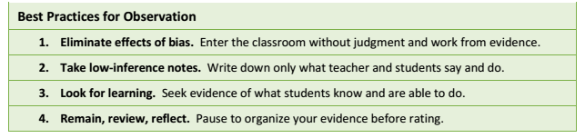
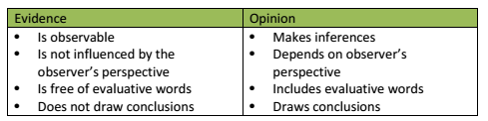
Putting It All Together
Now, you will use the entire IPG to observe a lesson.
As you observe the lesson, take low inference notes. What do you see and hear?
Notes:
Big Idea: Best Practices for Low-Inference Notes
Details:
Capturing high-quality notes during the observation is the first step in ensuring that ratings are accurate and feedback aligns to areas of improvement. Low-inference note-taking is a skill, not knowledge; it comes with practice. When taking low-inference notes, the observer describes what is taking place without drawing conclusions or making judgments about what he or she observes.
The resource, The Observation and Feedback Cycle: Best Practices for Low Inference Notes, (https://www.weteachnyc.org/media2016/filer_public/2a/d3/2ad3839f-eeae-42ba-8249-614b33136717/best_practices_for_low_inference_notes.pdf) is provided to build knowledge and capacity for this important skill.
Low-inference notes will provide an objective evidence base for reviewing and discussing the lesson throughout the toolkit.
Encourage participants to collect low-inference notes as often as possible. Remind participants to assume the role of researcher rather than evaluator and of coach rather than supervisor. The intent is not to pass judgment, but to highlight effective practices and to create a way to identify improvements needed and share best practices
If necessary:
Distribute The Observation and Feedback Cycle: Best Practices for Low Inference Notes handout
Discuss questions or comments based on the guidance provided.

Slide 50
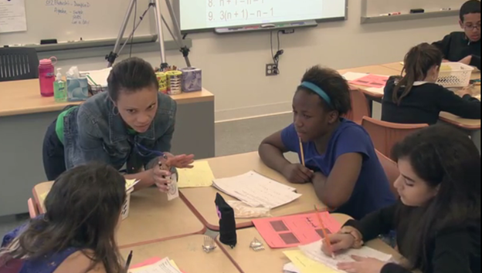
Observe a Lesson
Take low-inference notes. What do you see and hear?
Keep the Core Actions in mind, but don’t complete the Instructional Practice Guide yet.
Notes:
Before engaging in this activity, facilitators should identify how participants will observe a lesson (see Facilitator’s Guide for more information on this.)
Big Idea: Now that we’ve worked through all of the Core Actions, we’ll practice putting it all together and using the guide using a tool to focus conversations.
Details:
Observe a lesson and record low-inference notes. Assume positive intentions of the teacher and that he/she does what he/she thinks is in the best interest of his/her students. If you question what they’re doing, think about why someone might be think it’s the right thing to do. Be open and curious about what you see!
If watching a video, facilitators may want to have participants watch the video once before the session, if possible.
Remind participants to pay close attention to teacher-student interactions during the lesson: What does the teacher say and do? How are students engaged in the lesson and how does the teacher encourage that engagement? How are students demonstrating their understanding, their strategies for answering questions, or completing tasks?
Other helpful hints:
Participants should not worry about putting their notes into the right core actions, let alone the right core indicators! They should just capture notes and sort out where they belong immediately afterwards.
Participants should make sure their notes are ‘low inference’ that they are not judging what they are seeing but simply recording what they are seeing and hearing.
Participant may note questions they may have as they watch the lesson.
Background Knowledge: Videos to use can be found at https://achievethecore.org/category/1196/supplemental-lesson-videos.

Slide 51
After Watching the Lesson Video –
Complete the IPG
Spend time individually applying the low-inference notes you gathered from the lesson video to the indicators under each of the Core Actions.
Discuss the indicators and share the evidence with colleagues.
Notes:
Big Idea: Complete and discuss evidence for the indicators of the IPG. Create consensus on evidence for each indicator and the strengths and weaknesses of the lesson (Note: the purpose of this activity is not to come to consensus on the rating for each indicator)
Details:
Have participants look at Handout #9 for the directions for this activity.
Complete the IPG Coaching Tool by providing observational evidence for the appropriate indicators. It is not recommended that participants give ratings for each indicator so that the discussion can focus on identifying evidence that aligns to each indicator.
Although we are asking for evidence tied to each indicator, participants should note missed opportunities or times when the teacher or student did not engage in the indicator, as well as times when each indicator is being met.
After individually completing the IPG Coaching Tool, discuss first with a partner or in small table groups, then discuss evidence. Share reflections as a whole group.
Set the stage for the whole group discussion by reminding participants that this conversation is not meant to mirror how they would talk to the teacher about the lesson we just watched. The purpose is to discuss evidence for each of the indicators in order to have a shared understanding of what we just saw.
Some options for sharing: Have participants norm as a small group and then share with the full group (can be done with concretely using poster paper and post-it notes or digitally using a google doc spreadsheet.) It’s is often interesting to discuss indicators where there isn’t consensus.
After discussing, participants may want to note specific strengths and specific areas in need of growth to be used later in the lesson feedback summary. (Don’t use feedback summary form yet.)
Refer to the completed IPG Coaching Tool – Model Response for the model response for the lesson. Compare participants’ responses with the model response. Note: it is strongly recommended that while preparing for the presentation, the facilitator re-watches the video, paying attention to the moments that correspond to the time stamps in the model response.

Slide 52
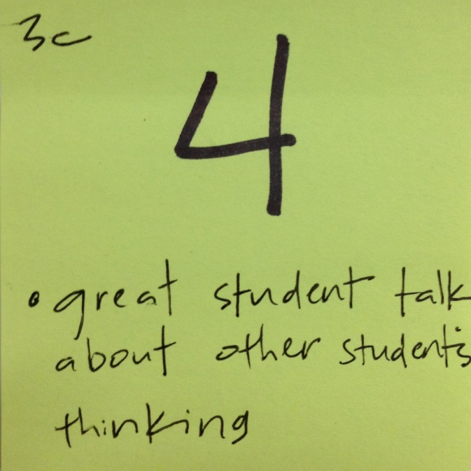

Putting It All Together: Gallery Walk
After your small group has come to consensus for each rating, write that rating and one piece of evidence for each indicator on a sticky note.
Place the sticky note for the specified indicator where others can access it.
Notes:
OPTIONAL: Debrief 360 with a gallery walk.
One option for sharing ratings for each indicator is to have a Gallery Walk. This works best for a large group when it might be difficult to have all voices heard. In a Gallery Walk, small groups that have come to consensus for each rating write their rating and one piece of evidence to support that rating on a sticky note. That sticky note is placed with the correct indicator on a surface where others can walk by and read all of the ratings for that indicator. The pictures above are examples of how the rating and a piece of evidence can share the same sticky note. On the right is an example of an indicator that was not able to be rated from the observed lesson. Instead of evidence the participant wrote the question or follow up with the teacher that needs to be done in order for that indicator to be rated.

Slide 53
Beyond the Lesson Discussion Guide
“After discussing the observed lesson, use the ‘Beyond the Lesson’ questions to help clearly delineate what practices are in place, what already occurred, and what opportunities might exist in another lesson, further in the unit, or over the course of the year to incorporate the Shifts into the classroom.”
Review the questions from the BTL Discussion Guide
Which questions would you prioritize for this lesson? Why?
Notes:
Big Idea: The Beyond the Lesson Discussion Guide is a good resource for questions that may come up in observing a single lesson.
Classroom observations are, by definition, limited to what you see while you are present in the room.
But learning happens over the course of days, across the weeks, and months of the school year. That needs to be accounted for in the coaching conversations with teachers.
Details:
Although we just identified strengths and areas for growth based on the video, we may be left with other questions.
The Beyond the Lesson Guide is a great resource for helping us frame the questions. We are going to take a quick look at it now and then revisit it when we are summarizing all of the things we learned about this lesson.
Have participants briefly discuss at their table which questions would help illuminate the lesson they just observed.

Slide 54
The Instructional Practice Guide can help guide us to…
Ensure the work of the enacted lesson reflects the Focus, Coherence, and Rigor required by college- and career-ready standards in mathematics (Core Action 1)
Employ instructional practices that allow all students to learn the content of the lesson (Core Action 2)
Provide all students with opportunities to exhibit mathematical practices while engaging with the content of the lesson (Core Action 3)
Notes:
Big Idea: So, we’ve now gone through the entire Instructional Practice Guide and looked closely at the Core Actions and indicators for each. We used the coaching tool to reflect on a lesson. In summary, we know that this tool will help us ensure our lessons and teaching are aligned to the Common Core and other college- and career-ready standards, and that all students are learning math content while simultaneously engaging in mathematical practices.

Slide 55

More Information on Instructional Practice Guides
There is a digital version of the Instructional Practice Guide available at achievethecore.org/coaching-tool
Notes:
Big Idea: Introducing the digital version of the IPG.
Details:
The IPG that you worked with for this professional development module was the print version. There is a digital version of the Instructional Practice Guide: Coaching tool for those who prefer to use technology over a printed document. All of the material is the same as what is included in the paper version. Some additional benefits of the digital version of the coaching tool include:
Typing your notes directly into the tool and being able to cut and paste them into the evidence sections for each indicator
Print, email, or export the observation with or without ratings and/or notes
Attach helpful resources from AchieveTheCore to the finished tool

Slide 56
More Information on Instructional Practice Guides
There are CCSS Instructional Practice Guides for:
  K-8 Math
  High School Math
  K-2 ELA/Literacy
  3-12 ELA/Literacy
All guides are available at achievethecore.org/instructional-practice.
Notes:
Big Idea: Share the other IPG versions and where you can find them.
Details:
As you can see from this list, there are a variety of Instructional Practice Guides available to use in a wide range of classroom settings.

Slide 57
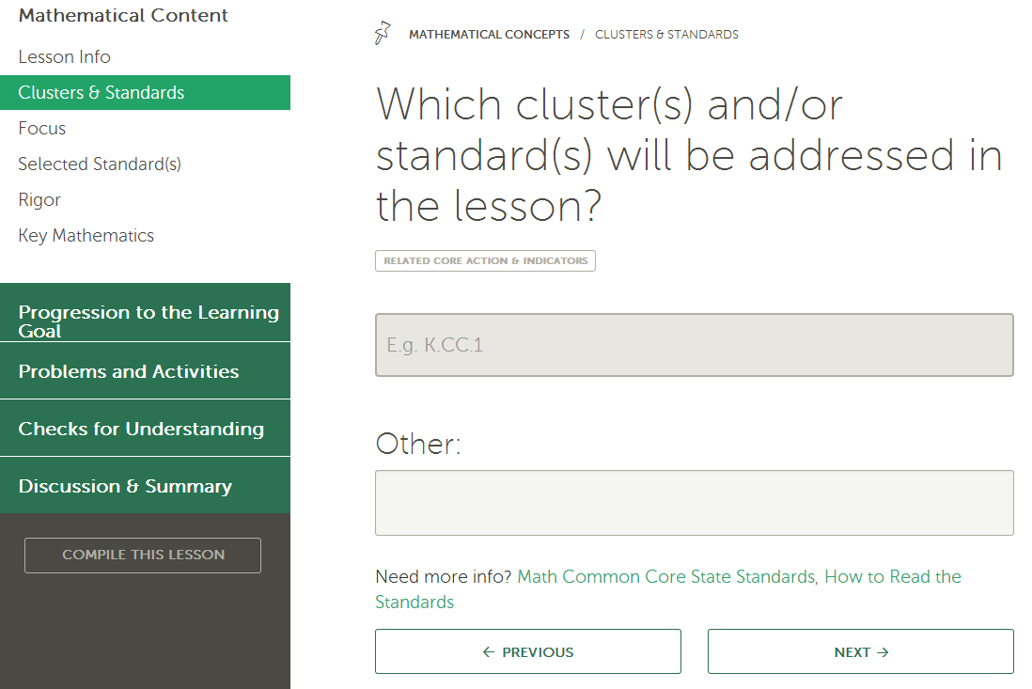
More Information
The Digital Lesson Planning tool is available at achievethecore.org/lesson-planning-tool
Notes:
Big Idea: More information on the digital Lesson Planning tool.
Details:
As mentioned earlier, there is a tool available to teachers that helps in planning lessons aligned to the Common Core and other college- and career-ready standards. The Instructional Practice Guide: Lesson Planning tool consists of sets of questions that are derived from the Core Actions and Indicators of the Daily Instructional Practice Guide. The questions guide teachers through planning a lesson that exemplifies the Shifts called for by the CCSS. The Lesson Planning tool is available for both ELA/Literacy and Math for all grades, K – High School. Teachers consider the standard(s) and/or cluster(s) they have chosen to target, the learning goal(s) for the students, the problems students will engage with, discussions about the mathematics of the lesson, using examples and representations to make the mathematics explicit, and how the lesson will be summarized, to name a few. The Lesson Planning tool compiles the responses into one document that users can save, edit, revise, print, export, and email. Multiple lessons can be started and saved to a user’s account.

Slide 58
Next Steps
How could the Instructional Practice Guide be useful in your setting?
Notes:
Big Idea: Reflect with participants about how the guides could or will be useful in their settings.
Details:
What IPG Core Actions need further professional learning support? Check out the resources at www.achievethecore.org

Slide 59

The Core Advocate Network
Who are the Core Advocates?
Core Advocates are educators who:
Believe in the potential of high-quality standards grounded in evidence to prepare all students for college and career.
Understand and embrace the Shifts in instruction and assessment required by college- and career-ready standards.
Are eager to support their colleagues and communities in understanding and translating the Shifts into instructional practice.
What do Core Advocates do?
As instructional advocates, Core Advocates lead other educators in their communities in understanding the Shifts, as well as sharing practices aligned to the Shifts and the standards. Among other actions, Core Advocates:
Lead professional development sessions and professional learning communities.
Create, refine, and share standards-aligned resources with the field.
Advocate for high-quality instruction, instructional resources, and professional learning.
Use and provide feedback on high-quality instructional tools and resources.
How can I get involved?
Join the Core Advocate Network by taking the Core Advocate survey at: www.achievethecore.org/ca-signup
Email coreadvocates@studentsachieve.net with any questions.

Slide 60

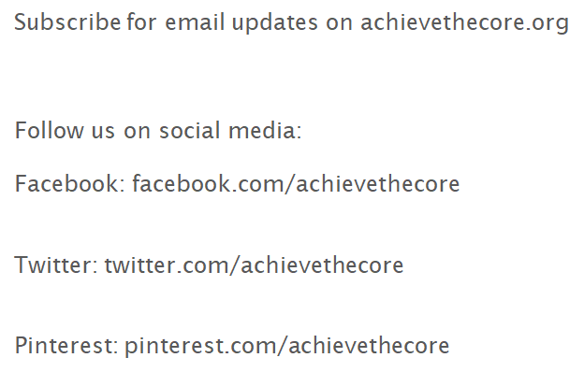




Slide 61
Thank you!

